Slide 1
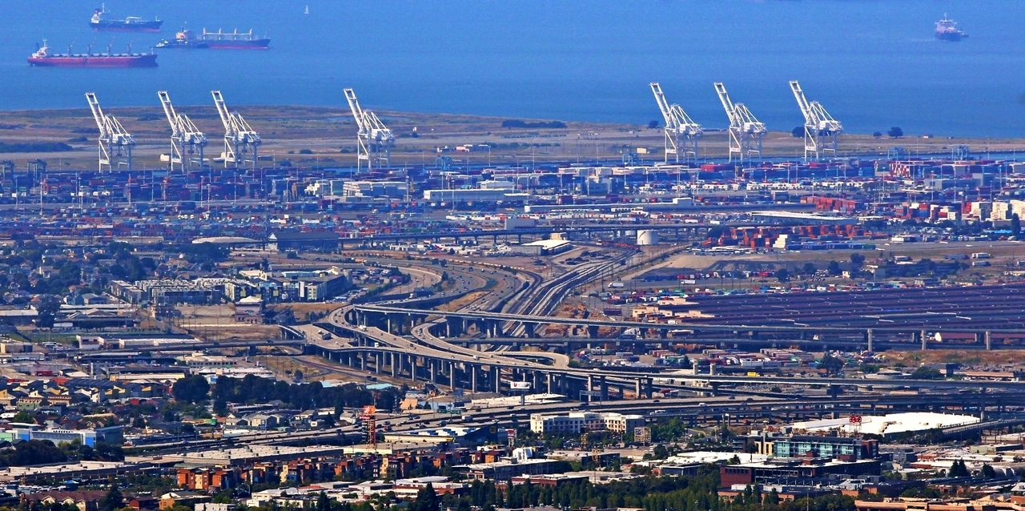
What is a model? What is a simulation?
Dr. Greg Erhardt
greg.erhardt@uky.edu CE599-002

Slide 2
Today’s Topics
What is a model?
Types of models
CORVID-19 Kaggle
Materials drawn from:
Michael Batty: What Are Models?
http://www.spatialcomplexity.info/files/2012/01/MRes-Lecture-1.pdf
Malleson & Happenstall: Social Simulation and Agent-Based Modelling
http://www.geog.leeds.ac.uk/courses/level3/geog3150/lectures/lecture3/
Erhardt: Advancing Knowledge in a Generalizable and Testable Manner
Kahani Kahsmir
https://www.slideshare.net/jannap/simulation-andmodeling

Slide 3
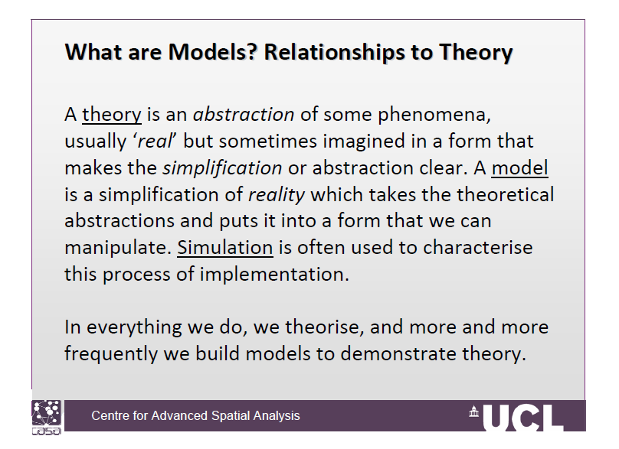

Slide 4
Some examples of models
Model cars
Fashion models
Role models
Maps
Blueprints
Flow charts
Equations
Computer simulations
Video games

Slide 5
Models and theory
A model is one way of formally articulating a theory.
We can do this through:
Writing
Math
Computer programs

Slide 6
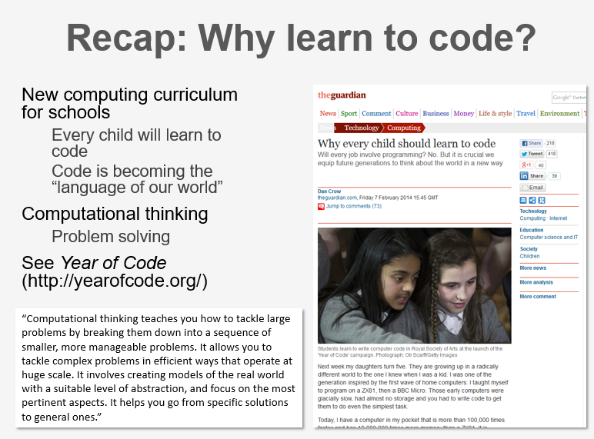
Malleson & Happenstall

Slide 7
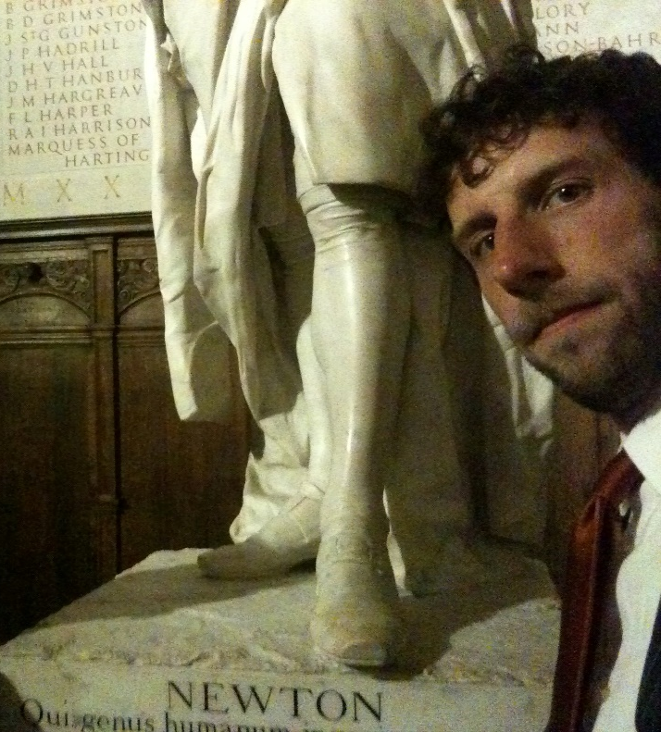
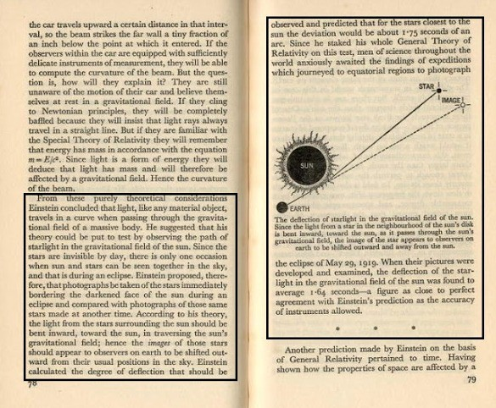
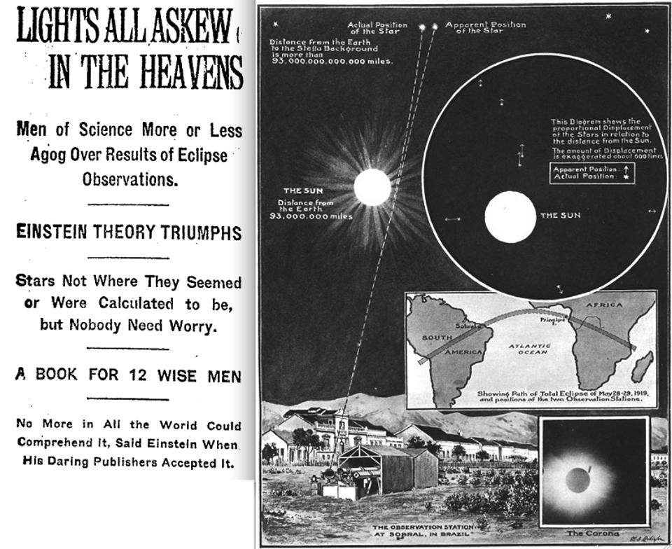
“Science was a series of models continuing to replace each other.”
Tolk, Andreas. “Learning Something Right from Models That Are Wrong: Epistemology of Simulation.” In Concepts and Methodologies for Modeling and Simulation, 87–106. Simulation Foundations, Methods and Applications. Springer, Cham, 2015.
Einstein’s model:
Was more general than Newton’s
Made testable predictions
But Newton’s model remains useful!

Slide 8
The role of modeling in science
“I have been, and remain, entirely committed to the idea that modeling is the essence of science and the habitat of all epistemology.
R. Rosen, Essays on Life Itself, 1500 edition. New York: Columbia University Press, 1999.

Slide 9
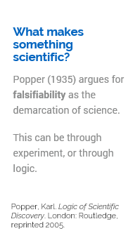
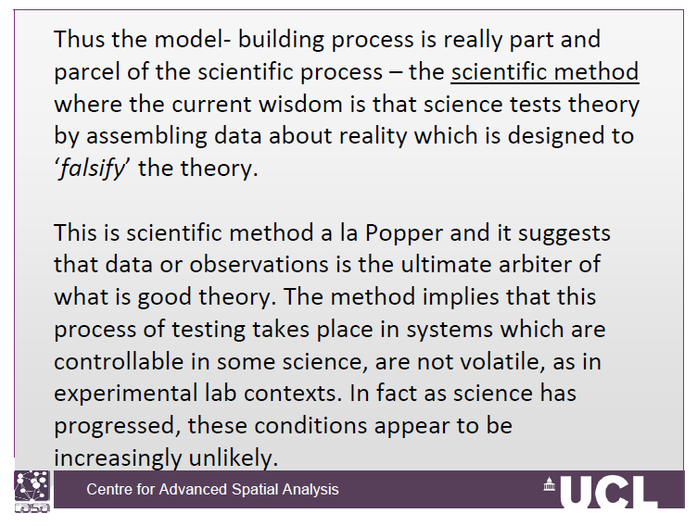
What makes a model scientific?

Slide 10
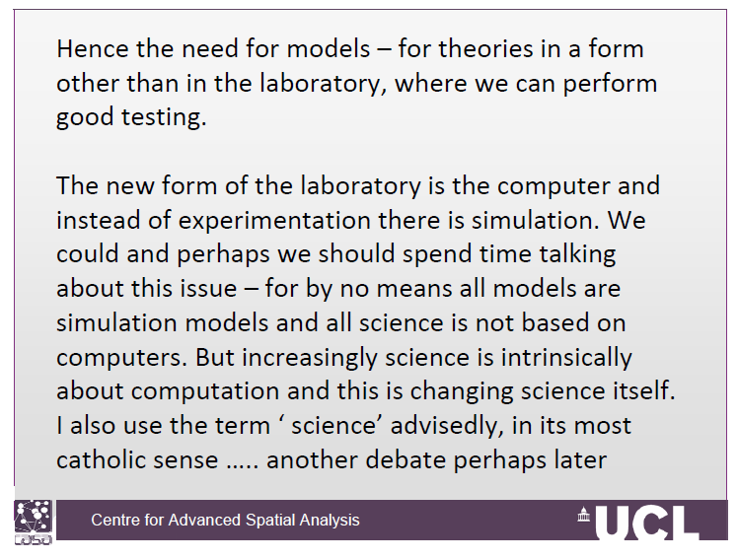
So we test it in the lab, right?
Typically we think of lab experiments as the means of testing theory.
This lets us control for confounding factors.
What if we can’t test it in the lab?
Look at the real world & parse out confounders
Use a model for virtual experiments

Slide 11
A few relevant types of models (not mutually exclusive)
Conceptual models
Mathematical models
Statistical models
Simulation models
Optimization models
Model systems
Agent-based models
Machine Learning Models

Slide 12
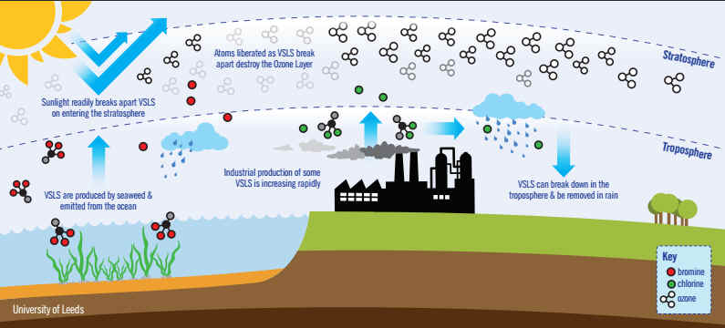
Conceptual Model
Candace Gilet, “Ozone depletion: Uncovering the hidden hazard of hairspray.” University of California Museum of Paleontology. https://undsci.berkeley.edu/article/0_0_0/ozone_depletion_01

Slide 13
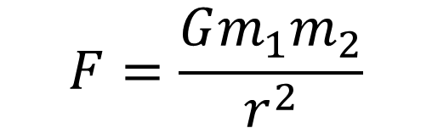
Mathematical Models
$$F=\frac{Gm_{1}m_{2}}{r^{2}}$$

Slide 14
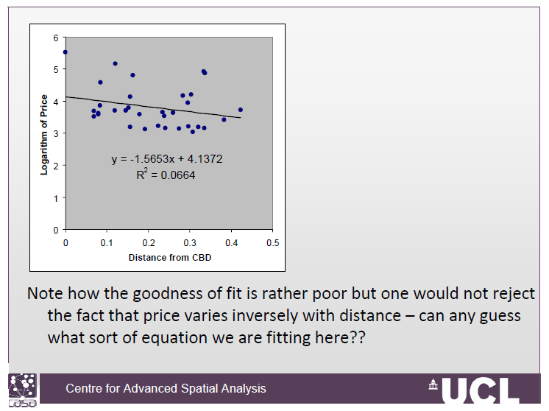
Statistical Models
Descriptive
Or
Predictive

Slide 15
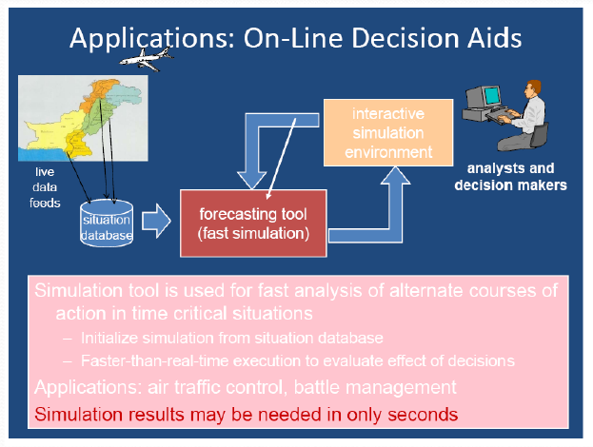
Simulation Models
If I do this, what will happen?
Kahani Kahsmir

Slide 16
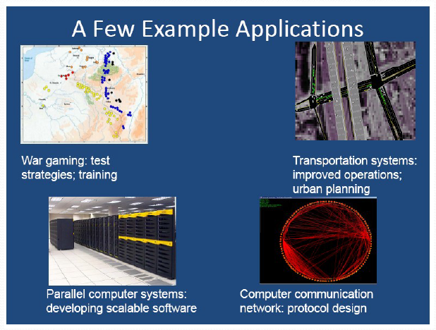
Simulation Models
If I do this, what will happen?
Kahani Kahsmir

Slide 17
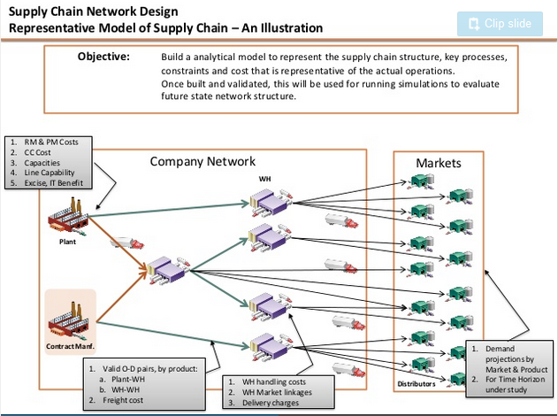
Optimization Models
What should I do?
https://www.slideshare.net/singhmk74/network-optimization-15088394

Slide 18
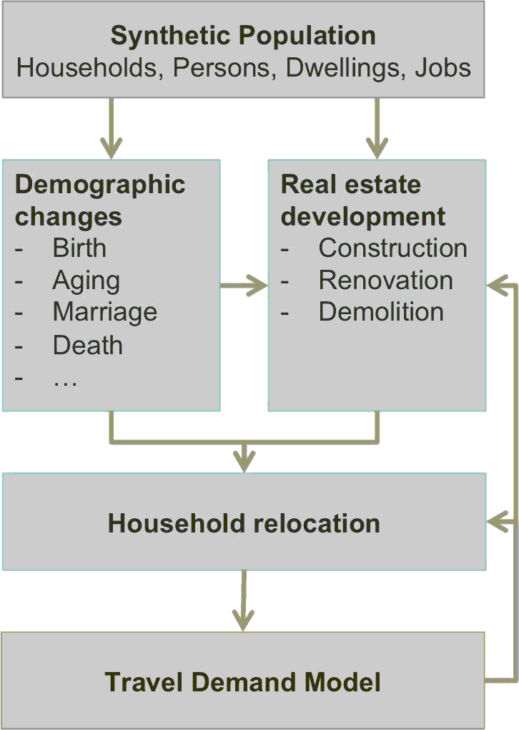
Model Systems
https://silo.zone/introduction.html

Slide 19
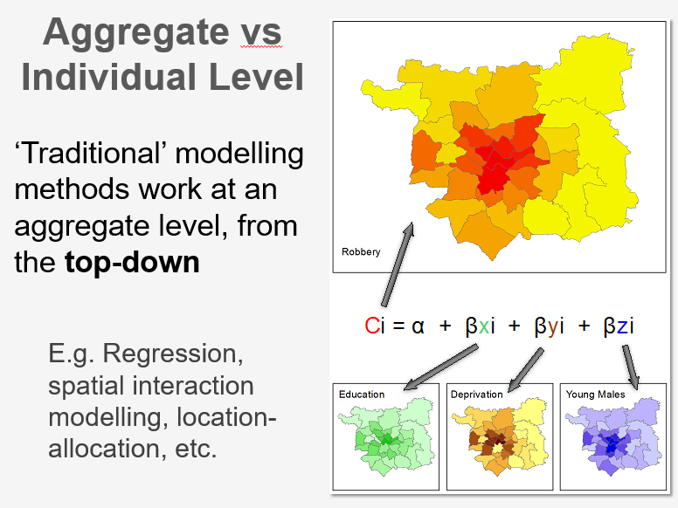

Slide 20
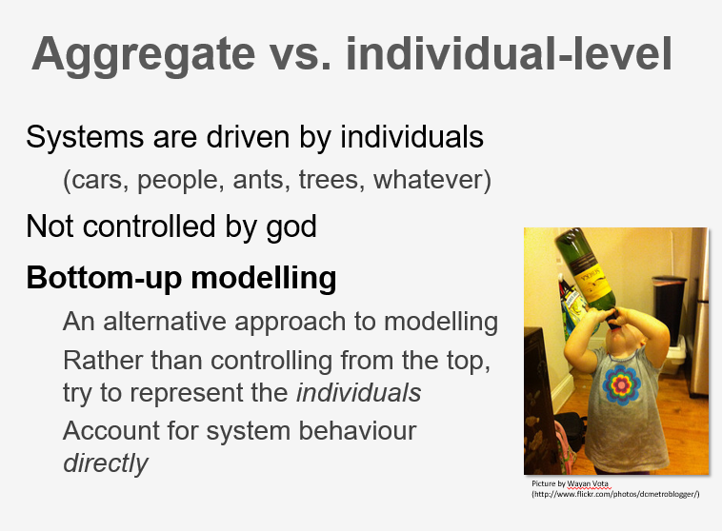

Slide 21
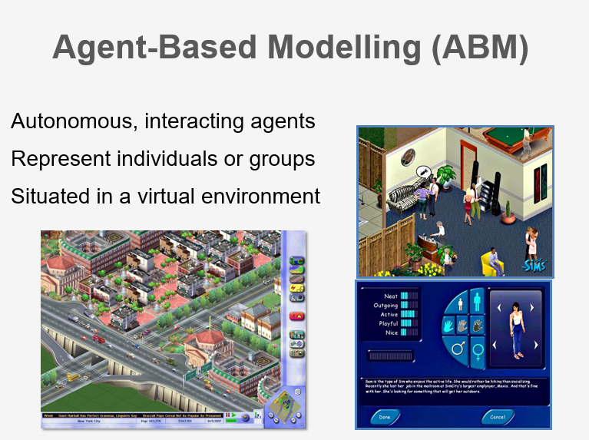

Slide 22
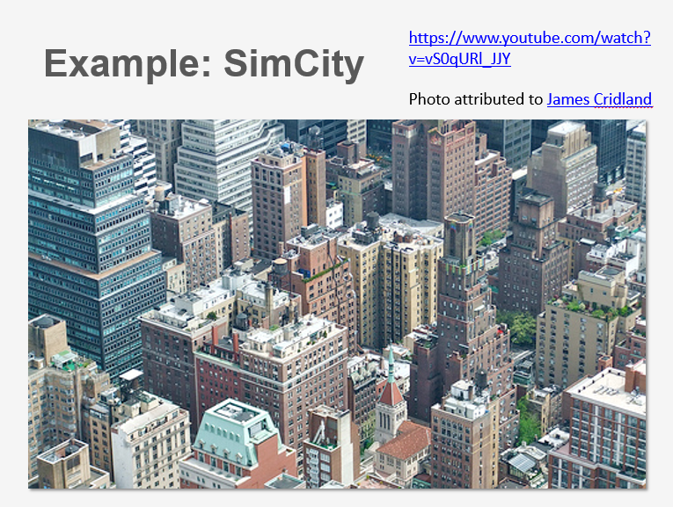
https://www.youtube.com/watch?v=vS0qURl_JJY

Slide 23
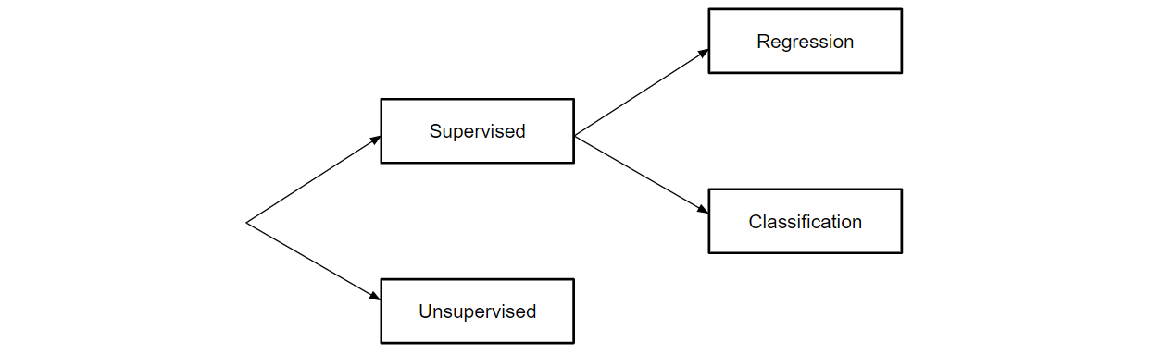
Machine Learning Models
https://towardsdatascience.com/all-machine-learning-models-explained-in-6-minutes-9fe30ff6776a

Slide 24
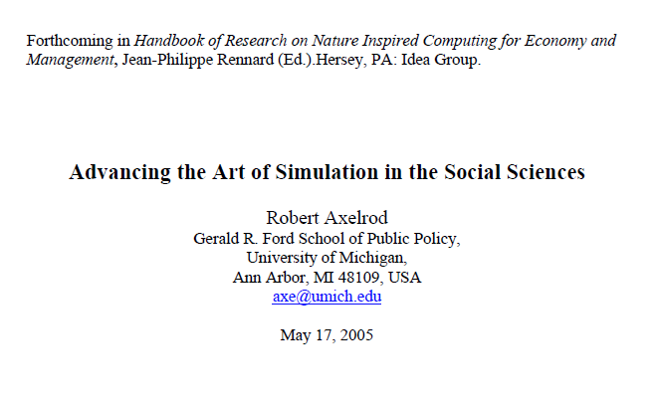
Reading
http://www-personal.umich.edu/~axe/research/AdvancingArtofSim.pdf

Slide 25
Models and Data
Usually we use data to test our models (and our theory).
What happens when our model is derived from data?

Slide 26
Example: Predicting the Spread of Cornovirus
https://www.kaggle.com/sudalairajkumar/novel-corona-virus-2019-dataset/tasks

Slide 27
Assignment
Read about simulation
Read about machine learning
Familiarize yourself with the coronavirus data set and come back with ideas for how to predict its spread
http://www-personal.umich.edu/~axe/research/AdvancingArtofSim.pdf
https://towardsdatascience.com/all-machine-learning-models-explained-in-6-minutes-9fe30ff6776a
https://www.kaggle.com/sudalairajkumar/novel-corona-virus-2019-dataset/tasks

